Slide 1
Nazareth http://www.youtube.com/watch?v=MH84D0dVKGk
By Rewa Hallaq and Fady Khateeb
Once-upon today
Berlin , Wrocław, Krzyżowa
21st – 30th September 2012
27 September, 2012

Slide 2
Nazareth – city of magic
http://www.youtube.com/watch?v=wEIb1YtyFXw

Slide 3
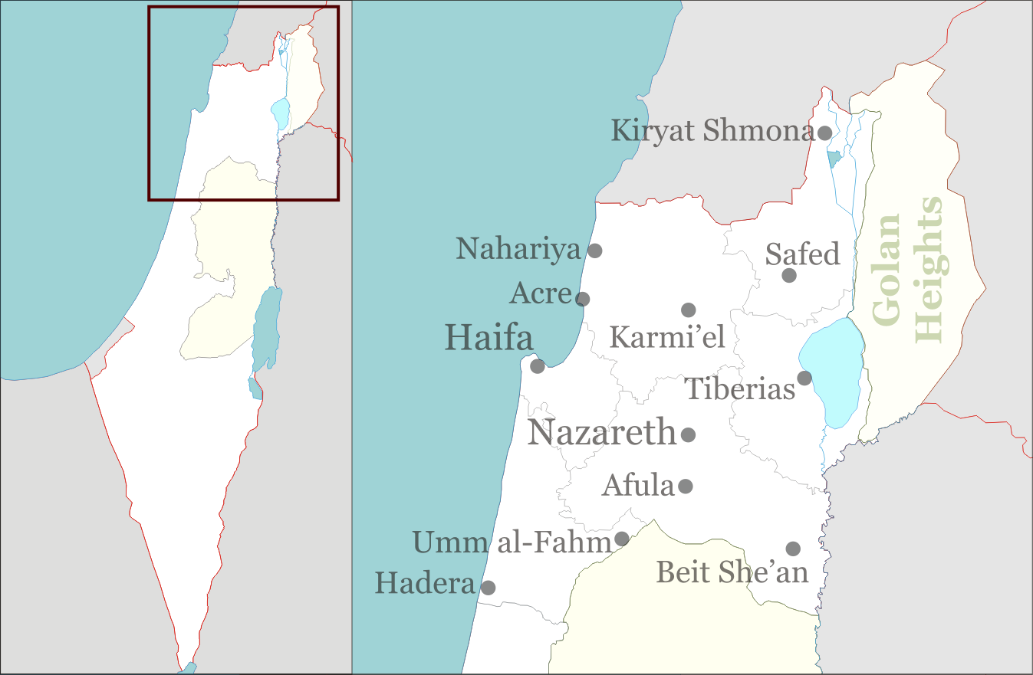
Place of Nazareth on earth

Slide 4
Information about Nazareth
Natzeret; Arabic: اَلنَّاصِرَة‎ an-Nāṣira is the largest city in the north district of Israel.
Jesus (Arabic: يَسُوع‎, Yasū` or Arabic: عِيسَى‎, `Īsā) is also called an-Nāṣirī.
The population is made up of 125,000 civilians of Arab citizens of Israel: Muslim (69%) and Christian (30.9%).
The city absorbed Palestinian fugitives from neighboring towns during the 1948 Arab-Israeli war.
In the New Testament, the city is described as the childhood home of Jesus, and as such is a center of Christian pilgrimage, with many shrines commemorating biblical events.
Nazareth also hosts traditional and cultural events through the year.

Slide 5
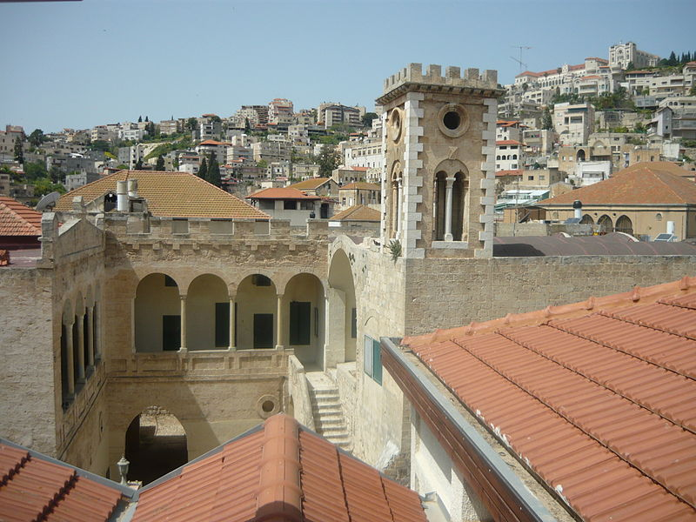
View from Nazareth

Slide 6
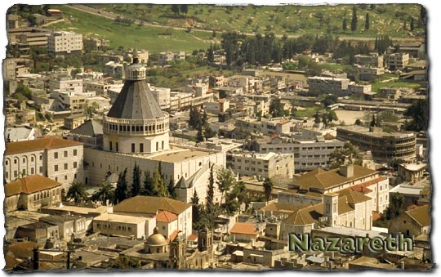

Slide 7
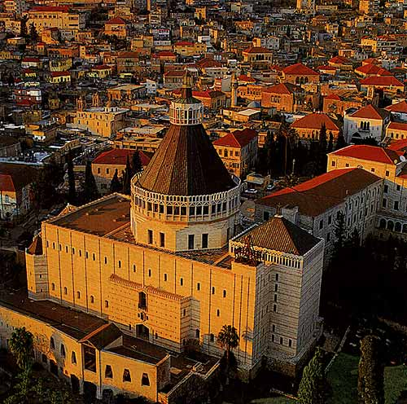

Slide 8
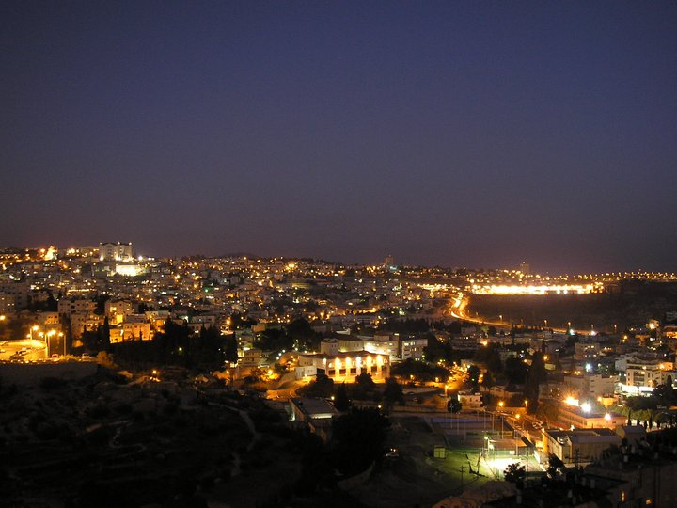
Nazareth at night

Slide 9
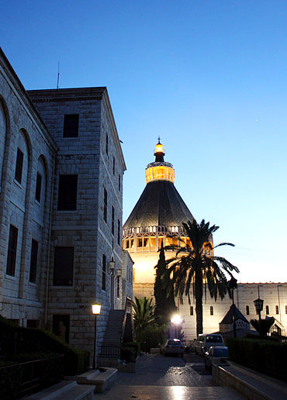
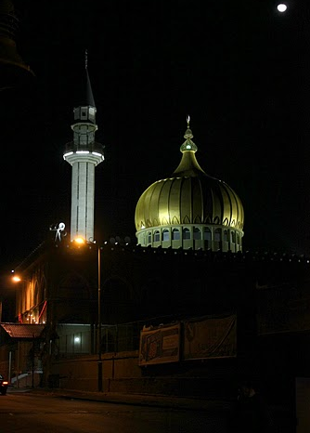
Places in Nazareth
Church of the Annunciation
Makam al-Nabi Sain Mosque

Slide 10
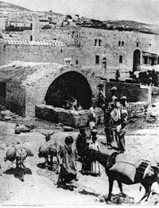
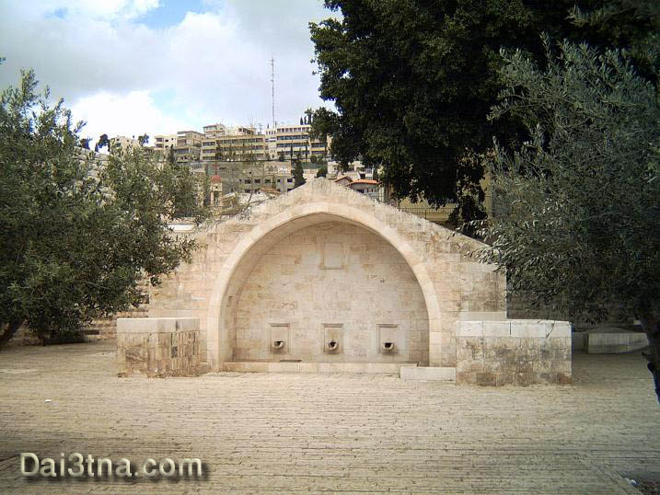
Mary's well in Nazareth Holy Place

Slide 11
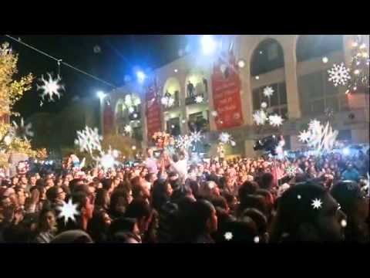
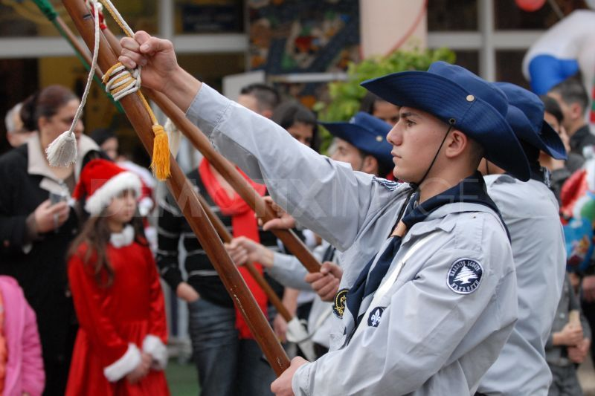
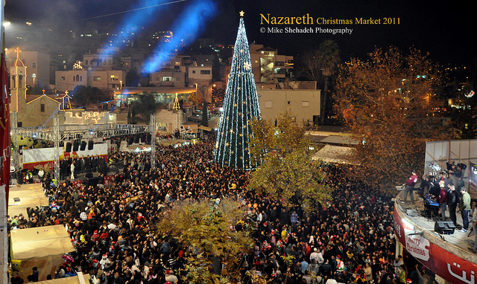
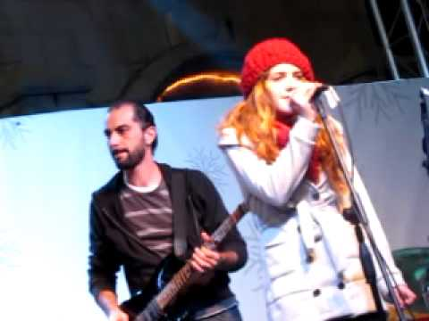
Nazareth Celebration

Slide 12
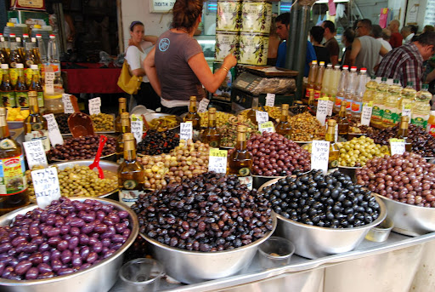
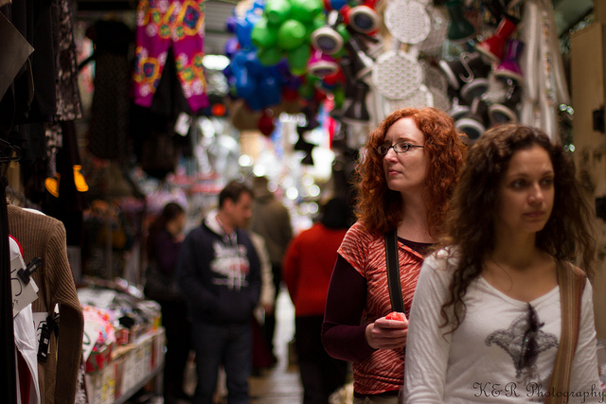
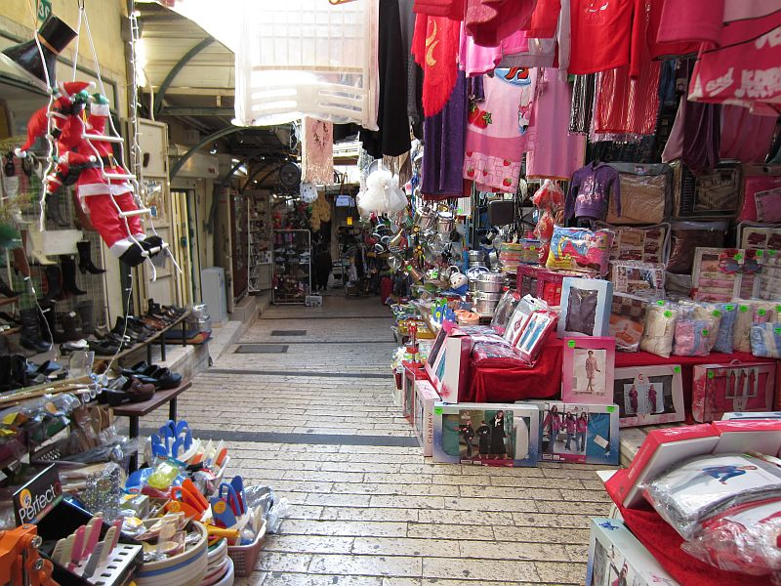
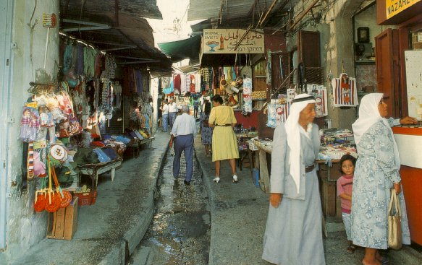
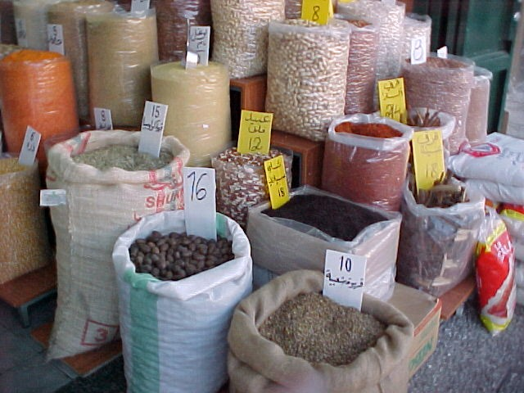
Nazareth market place

Slide 13
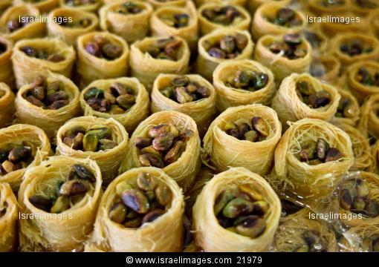
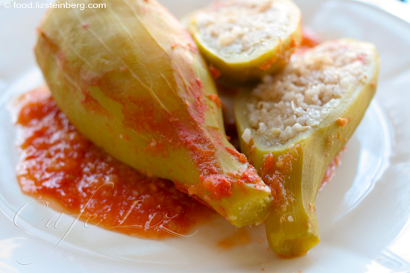
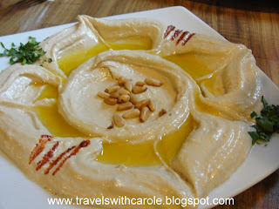
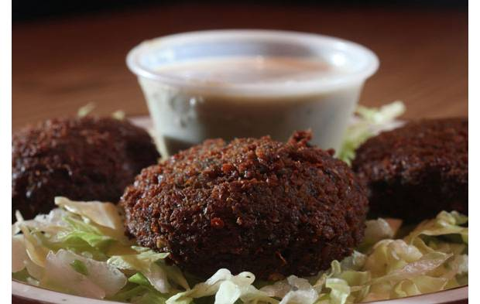
Food from Nazareth

Slide 14
http://www.masar-edu.org/?todo=school

